Slide 1
Zomato analysis
Group 1

Slide 2
Overview of the project
Zomato Restaurant Data Analysis Project - This project involved analysing Zomato restaurant data using advanced Excel functions and SQL queries to get meaningful insights from the Data and creating interactive dashboards using Power BI and Tableau.

Slide 3
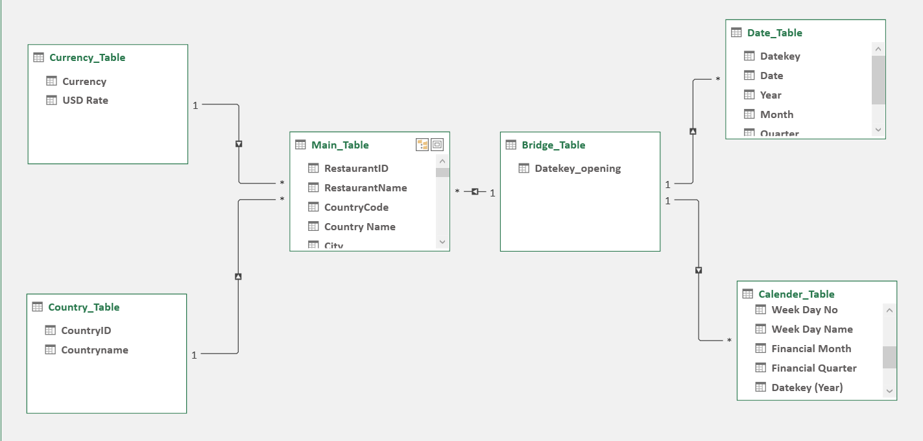
Data model

Slide 4
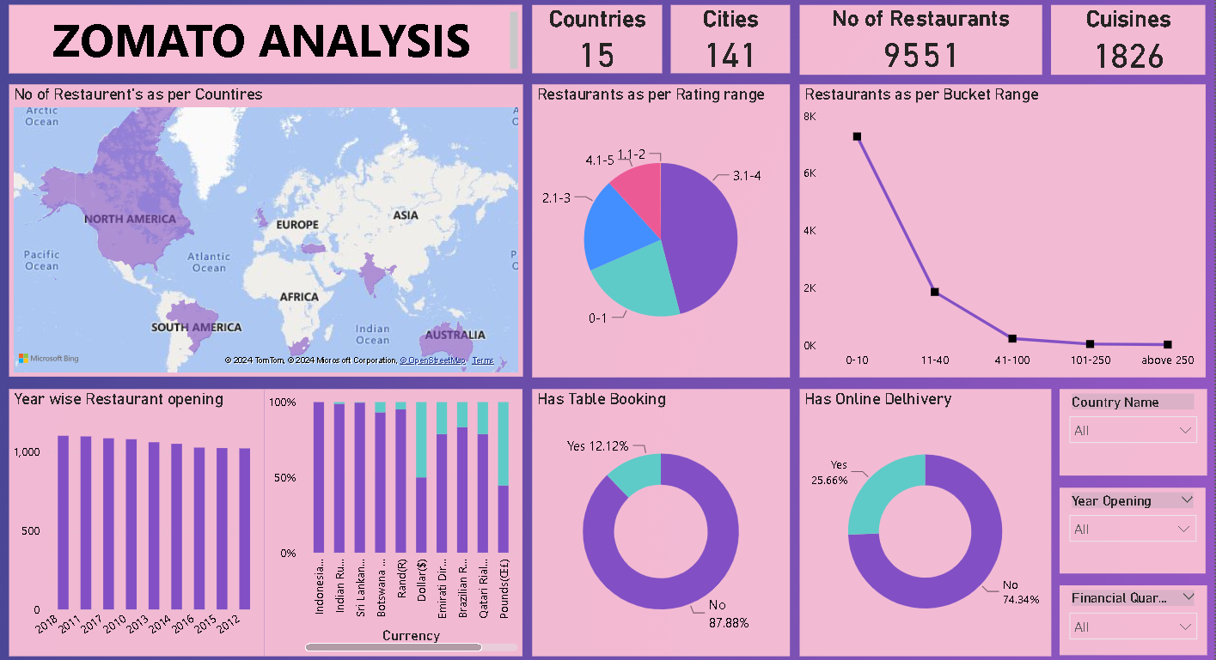
Dashboard

Slide 5
Conclusions
This dataset geographically covers Restaurants present in India and 14 other countries where the Delhi NCR Area alone has 7974 Restaurants of the total 9551 Restaurants present in the Dataset , this information can be used for localized market analysis
When all currencies are converted into Dollars the 0-10 $ Bucket Range is most profitable with 7273 Restaurants providing this Range
72% of the Restaurants don’t have Online Delivery and 87.16% of Restaurants do not have Online table Booking
North Indian is the most popular cuisine among the customers followed by Chinese , Fast food , Mughlai and Bakery
The inclusion of opening dates allows for a temporal analysis of market trends, restaurant longevity, and the impact of seasonal variations on restaurant openings.

Slide 6
Suggestions
The Average cost of two and price range can be used to segmentize the budget range such as low , mid and high thus allowed targeted market strategies for the particular range.
Most restaurants do not offer online delivery and table booking following the traditional dining culture , This creates an opportunity for introducing these services as these services increase the customer reach
Most popular restaurants highly contribute in high sales and profit also resulting in high customer satisfaction thus these restaurants should be expanded more and more has they are more reliable In terms of sales and profit , currently the most popular restaurants are Cafe Coffee Day (84) , Domino’s Pizza (80) , Subway (64) , Green Chik Chop (52) and McDonald’s (49)
Zomato should expand into more countries to capture more market and to have high customer reach

Slide 7
Thank you

